Slide 1
Variables and Types

Slide 2
Table of contents
Value Types and Reference Types
Nullable types
Anonymous Type
Dynamic Types
Generics
Struct
Enum
StringBuilder
Partial class

Slide 3
Data types in C#
In C# programming language, Data Types are used to define a type of data the variable can hold such as integer, float, string, etc. in our application.
C# is a Strongly Typed programming language so before we perform any operation on variables, it’s mandatory to define a variable with the required data type to indicate what type of data that variable can hold in our application.

Slide 4
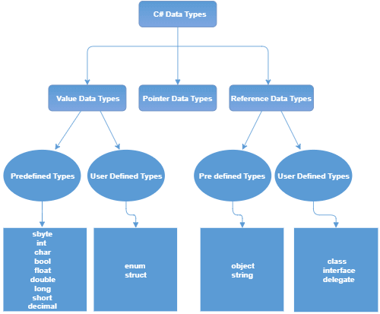
Data types in C#

Slide 5
Value Types and Reference Types
In C#, these data types are categorized based on how they store their value in the memory. C# includes the following categories of data types:
Value type
Reference type
Pointer type

Slide 6
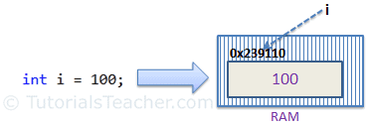
Value Type
A data type is a value type if it holds a data value within its own memory space. It means the variables of these data types directly contain values.
All the value types derive from System.ValueType, which in-turn, derives from System.Object.
For example, consider integer variable int i = 100;
The system stores 100 in the memory space allocated for the variable i. The following image illustrates how 100 is stored at some hypothetical location in the memory (0x239110) for 'i':

Slide 7
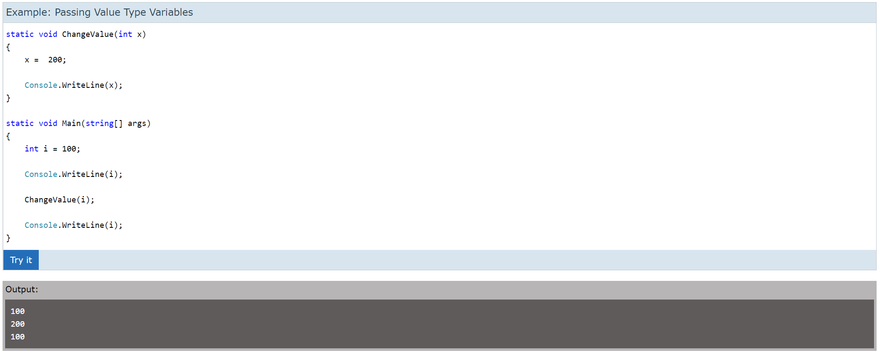
Passing Value Type Variables
When you pass a value-type variable from one method to another, the system creates a separate copy of a variable in another method. If value got changed in the one method, it wouldn't affect the variable in another method.

Slide 8
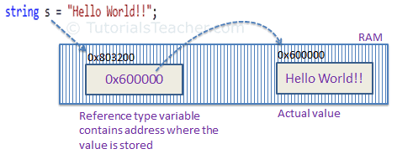
Reference Type
Unlike value types, a reference type doesn't store its value directly. Instead, it stores the address where the value is being stored. In other words, a reference type contains a pointer to another memory location that holds the data.
For example, consider the following string variable:
string s = "Hello World!!";

Slide 9
Reference Type
Reference type stores the address of the location where the actual value is stored instead of the value itself.
The followings are reference type data types:
String
Arrays (even if their elements are value types)
Class
Delegate

Slide 10
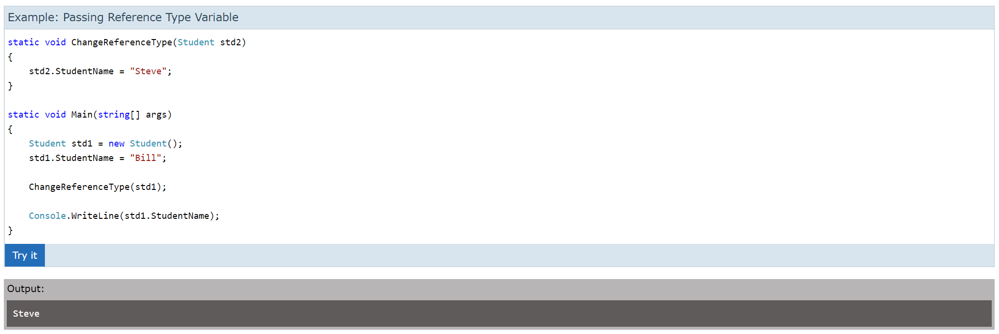
Passing Reference Type Variables
When you pass a reference type variable from one method to another, it doesn't create a new copy; instead, it passes the variable's address. So, If we change the value of a variable in a method, it will also be reflected in the calling method.

Slide 11
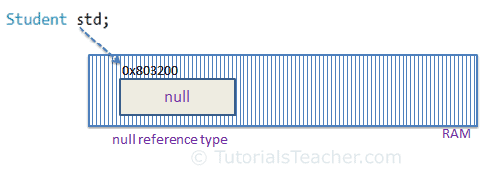
Null
The default value of a reference type variable is null when they are not initialized. Null means not referring to any object.
A value type variable cannot be null because it holds value, not a memory address.
C# 2.0 introduced nullable types, using which you can assign null to a value type variable or declare a value type variable without assigning a value to it.

Slide 12
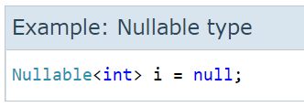
Nullable types
As you know, a value type cannot be assigned a null value. For example, int i = null will give you a compile time error.
You can declare nullable types using Nullable<T> where T is a type.
A nullable type can represent the correct range of values for its underlying value type, plus an additional null value. For example, Nullable<int> can be assigned any value from -2147483648 to 2147483647, or a null value.

Slide 13
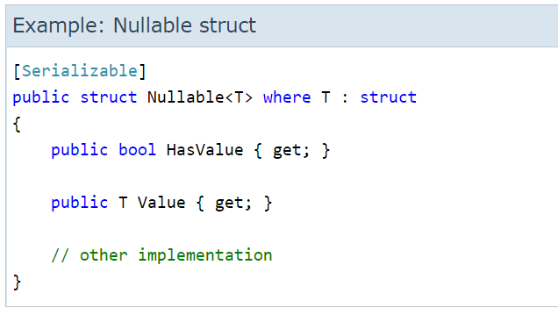
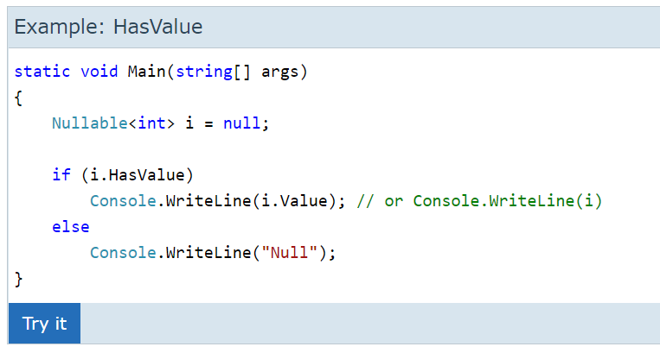
Nullable types
The Nullable types are instances of System.Nullable<T> struct.
A nullable of type int is the same as an ordinary int plus a flag that says whether the int has a value or not (is null or not). All the rest is compiler magic that treats "null" as a valid value.

Slide 14
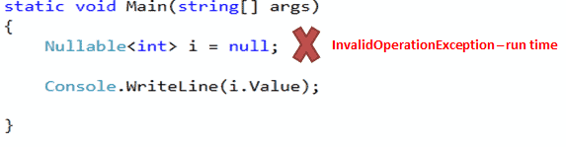
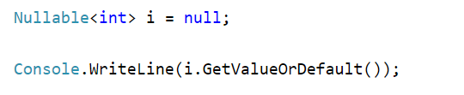
Nullable types
The HasValue returns true if the object has been assigned a value; if it has not been assigned any value or has been assigned a null value, it will return false.
Accessing the value using NullableType.Value will throw a runtime exception if nullable type is null or not assigned any value. For example, i.Value will throw an exception if i is null:
Use the GetValueOrDefault() method to get an actual value if it is not null and the default value if it is null. For example:

Slide 15
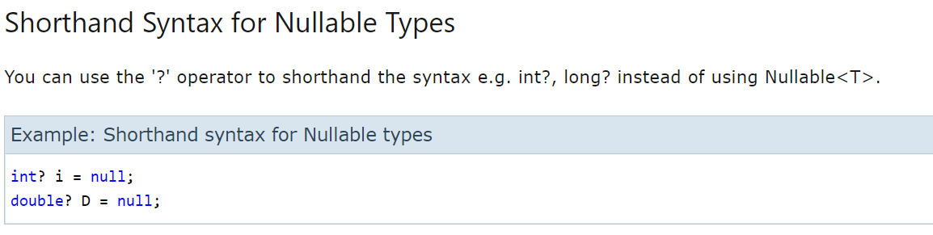
Nullable types

Slide 16
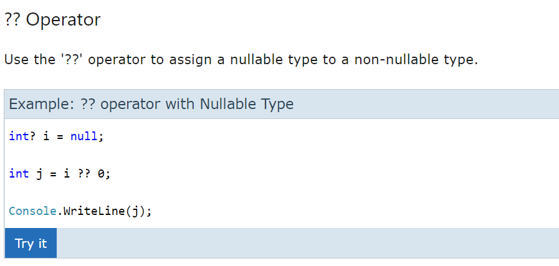
Nullable types

Slide 17
Nullable types
Characteristics of Nullable Types
Nullable types can only be used with value types.
The Value property will throw an InvalidOperationException if value is null; otherwise it will return the value.
The HasValue property returns true if the variable contains a value, or false if it is null.
You can only use == and != operators with a nullable type. For other comparison use the Nullable static class.
Nested nullable types are not allowed. Nullable<Nullable<int>> i; will give a compile time error.

Slide 18
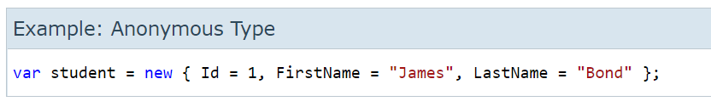
Anonymous Type
In C#, an anonymous type is a type (class) without any name that can contain public read-only properties only. It cannot contain other members, such as fields, methods, events, etc.
You create an anonymous type using the new operator with an object initializer syntax. The implicitly typed variable- var is used to hold the reference of anonymous types.
The following example demonstrates creating an anonymous type variable student that contains three properties named Id, FirstName, and LastName.

Slide 19
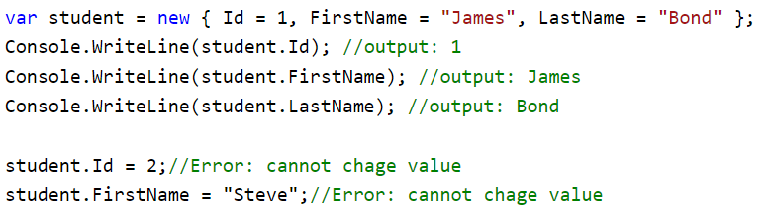
Anonymous Type
The properties of anonymous types are read-only and cannot be initialized with a null, anonymous function, or a pointer type. The properties can be accessed using dot (.) notation, same as object properties. However, you cannot change the values of properties as they are read-only.

Slide 20
Dynamic Types
C# 4.0 (.NET 4.5) introduced a new type called dynamic that avoids compile-time type checking. A dynamic type escapes type checking at compile-time; instead, it resolves type at run time.
A dynamic type variables are defined using the dynamic keyword.
The compiler compiles dynamic types into object types in most cases. However, the actual type of a dynamic type variable would be resolved at run-time.
The dynamic type variables is converted to other types implicitly.

Slide 21
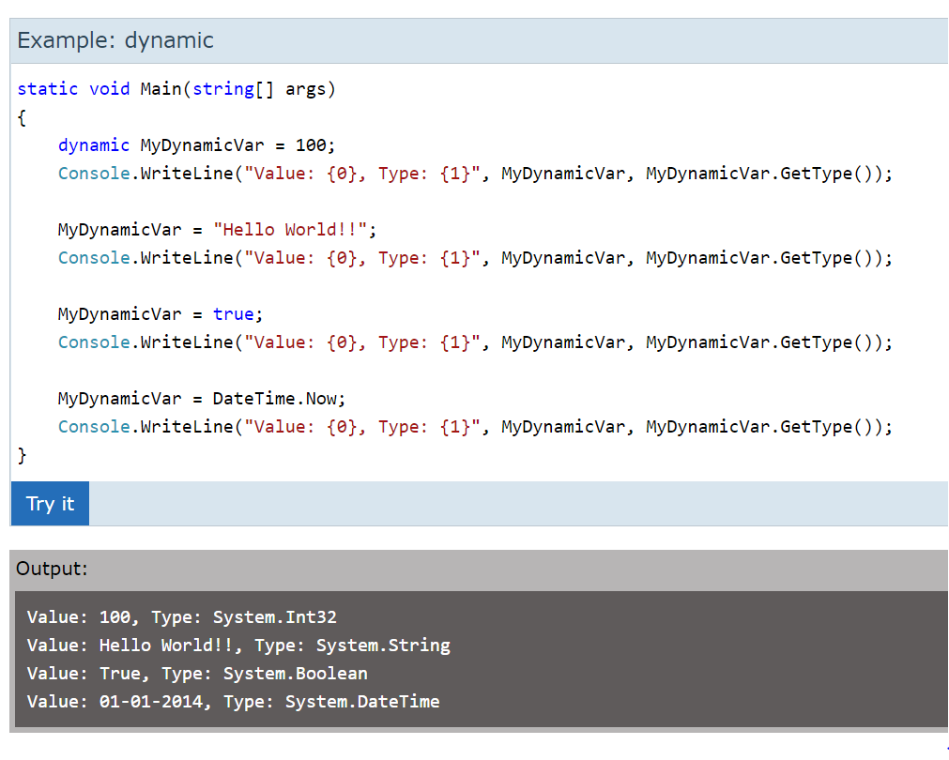
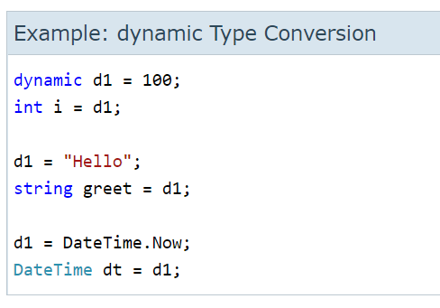
Dynamic Types

Slide 22
Generics
Generic means the general form, not specific. In C#, generic means not specific to a particular data type.
C# allows you to define generic classes, interfaces, abstract classes, fields, methods, static methods, properties, events, delegates, and operators using the type parameter and without the specific data type. A type parameter is a placeholder for a particular type specified when creating an instance of the generic type.
A generic type is declared by specifying a type parameter in an angle brackets after a type name, e.g. TypeName<T> where T is a type parameter.

Slide 23
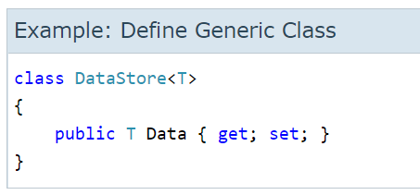
Generic Class
Generic classes are defined using a type parameter in an angle brackets after the class name. The following defines a generic class.
Above, the DataStore is a generic class. T is called type parameter, which can be used as a type of fields, properties, method parameters, return types, and delegates in the DataStore class. For example, Data is generic property because we have used a type parameter T as its type instead of the specific data type.

Slide 24
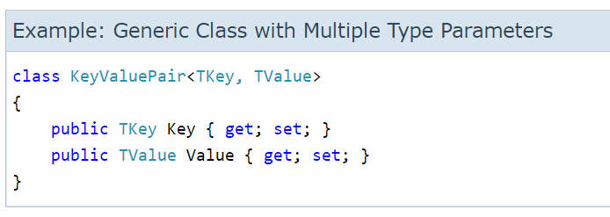
Generic Class
You can also define multiple type parameters separated by a comma.

Slide 25
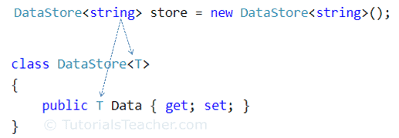
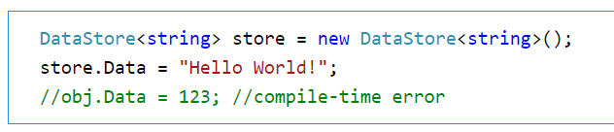
Generic Class
You can create an instance of generic classes by specifying an actual type in angle brackets.

Slide 26
Generic Class Characteristics
A generic class increases the reusability. The more type parameters mean more reusable it becomes. However, too much generalization makes code difficult to understand and maintain.
A generic class can be a base class to other generic or non-generic classes or abstract classes.
A generic class can be derived from other generic or non-generic interfaces, classes, or abstract classes.

Slide 27
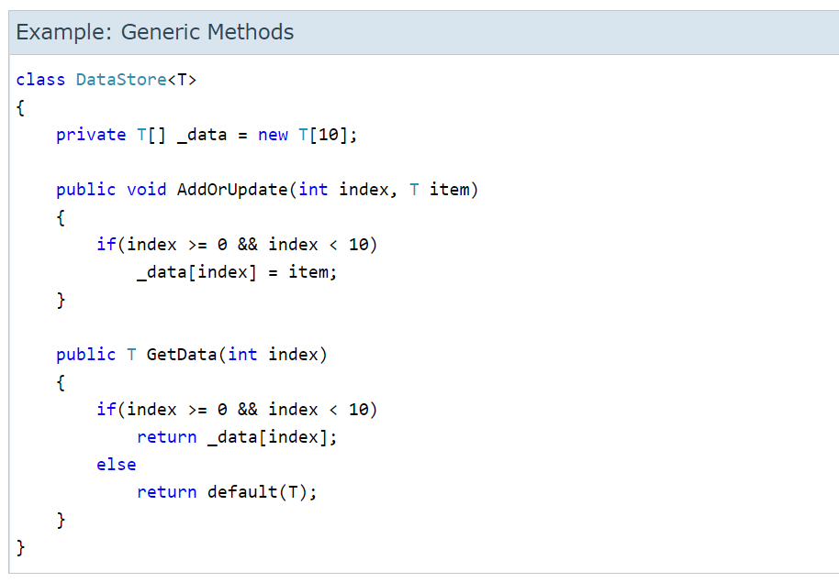
Generic Methods
A method declared with the type parameters for its return type or parameters is called a generic method.

Slide 28
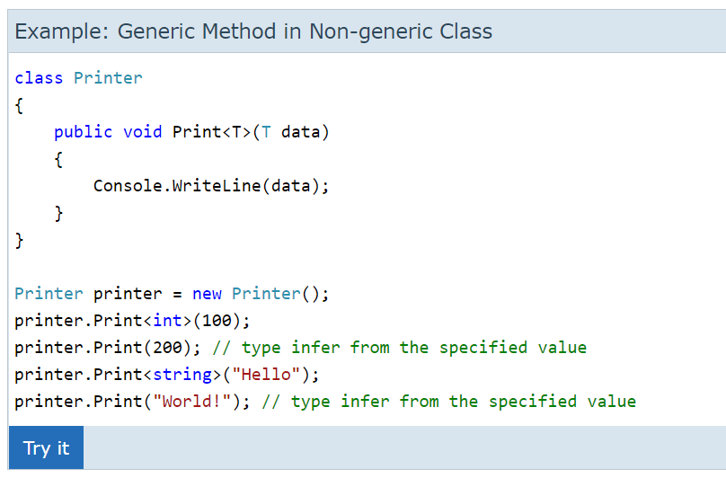
Generic Methods
A non-generic class can include generic methods by specifying a type parameter in angle brackets with the method name, as shown below.

Slide 29
Generics
Advantages of Generics
Generics increase the reusability of the code. You don't need to write code to handle different data types.
Generics are type-safe. You get compile-time errors if you try to use a different data type than the one specified in the definition.
Generic has a performance advantage because it removes the possibilities of boxing and unboxing.

Slide 30
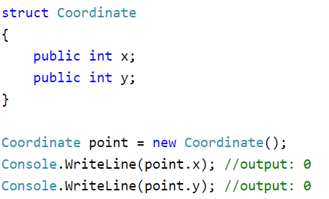
Struct
In C#, struct is the value type data type that represents data structures. It can contain a parameterized constructor, static constructor, constants, fields, methods, properties, indexers, operators, events, and nested types.
Struct can be used to hold small data values that do not require inheritance, e.g. coordinate points, key-value pairs, and complex data structure.

Slide 31
Struct
Struct is a value type, so it is faster than a class object. Use struct whenever you want to just store the data. Generally, structs are good for game programming. However, it is easier to transfer a class object than a struct. So do not use struct when you are passing data across the wire or to other classes.
struct can include constructors, constants, fields, methods, properties, indexers, operators, events & nested types.
struct cannot include a parameterless constructor or a destructor.
struct can implement interfaces, same as class.
struct cannot inherit another structure or class, and it cannot be the base of a class.
struct members cannot be specified as abstract, sealed, virtual, or protected.

Slide 32
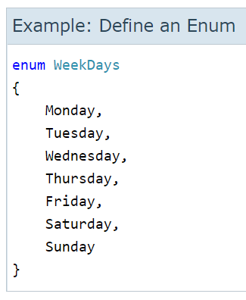
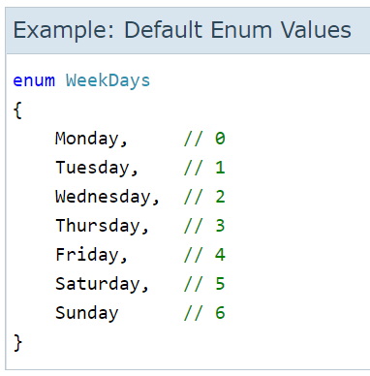
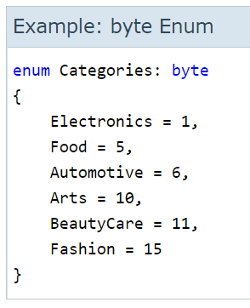
Enum
In C#, an enum (or enumeration type) is used to assign constant names to a group of numeric integer values. It makes constant values more readable, for example, WeekDays.Monday is more readable then number 0 when referring to the day in a week.
An enum is defined using the enum keyword, directly inside a namespace, class, or structure. All the constant names can be declared inside the curly brackets and separated by a comma.

Slide 33
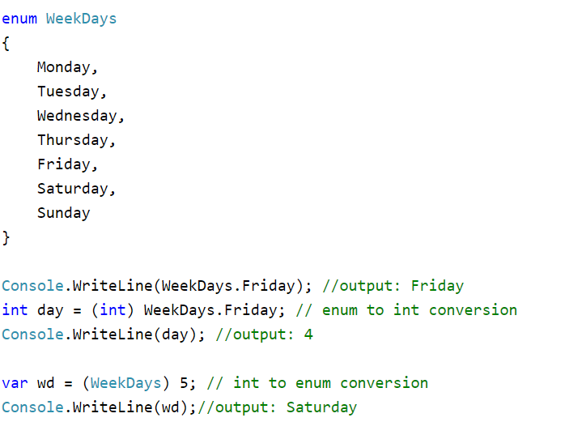
Enum
An enum can be accessed using the dot syntax: enum.member
Explicit casting is required to convert from an enum type to its underlying integral type.

Slide 34
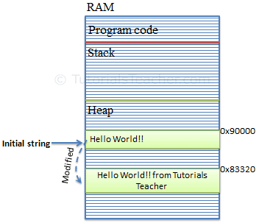
StringBuilder
In C#, the string type is immutable. It means a string cannot be changed once created. For example, a new string, "Hello World!" will occupy a memory space on the heap. Now, by changing the initial string "Hello World!" to "Hello World! From Tutorials Teacher" will create a new string object on the memory heap instead of modifying an original string at the same memory address. This behavior would hinder the performance if the original string changed multiple times by replacing, appending, removing, or inserting new strings in the original string.

Slide 35
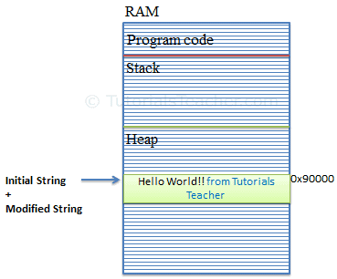
StringBuilder
To solve this problem, C# introduced the StringBuilder in the System.Text namespace. The StringBuilder doesn't create a new object in the memory but dynamically expands memory to accommodate the modified string.

Slide 36
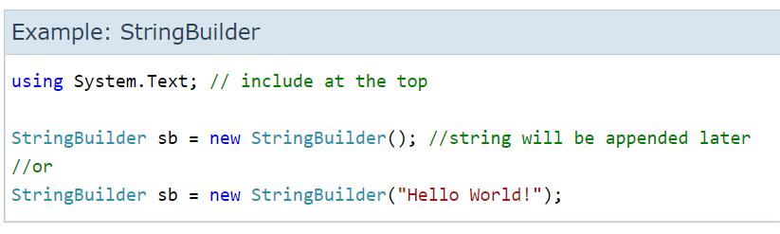
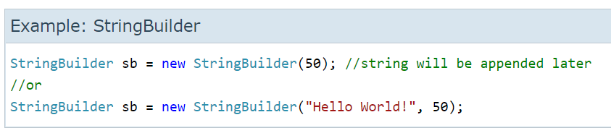
Creating a StringBuilder Object

Slide 37
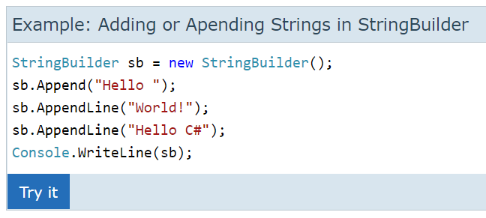
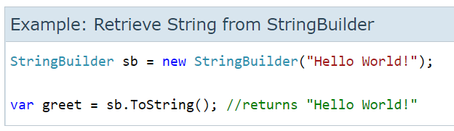
Using a StringBuilder Object

Slide 38
StringBuilder - Points to Remember
StringBuilder is mutable.
StringBuilder performs faster than string when appending multiple string values.
Use StringBuilder when you need to append more than three or four strings.
Use the Append() method to add or append strings to the StringBuilder object.
Use the ToString() method to retrieve a string from the StringBuilder object.

Slide 39
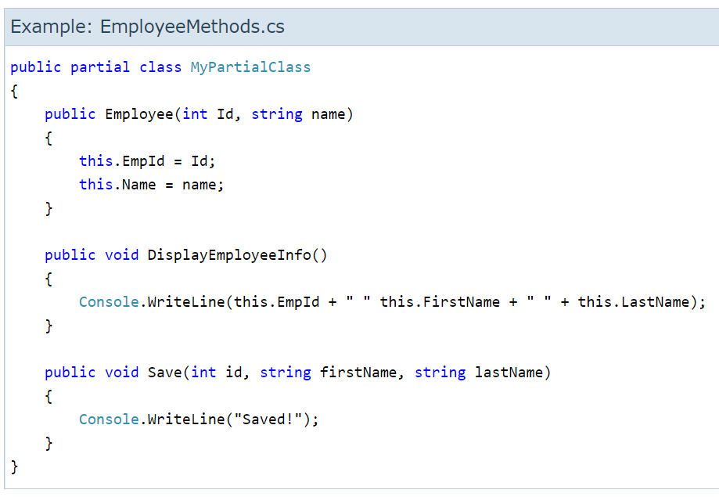
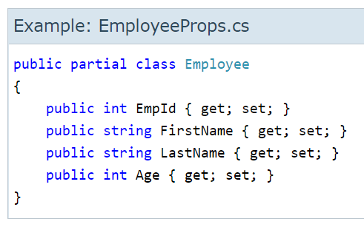
Partial Class
In C#, you can split the implementation of a class, a struct, a method, or an interface in multiple .cs files using the partial keyword. The compiler will combine all the implementation from multiple .cs files when the program is compiled.
Consider the following EmployeeProps.cs and EmployeeMethods.cs files that contain the Employee class.

Slide 40
Rules for Partial Classes
All the partial class definitions must be in the same assembly and namespace.
All the parts must have the same accessibility like public or private, etc.
If any part is declared abstract, sealed or base type then the whole class is declared of the same type.
Different parts can have different base types and so the final class will inherit all the base types.
The Partial modifier can only appear immediately before the keywords class, struct, or interface.
Nested partial types are allowed.

Slide 41
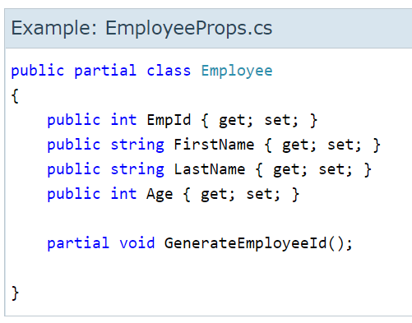
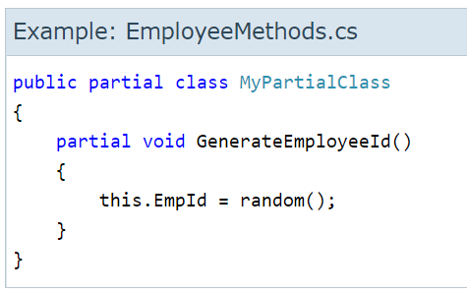
Partial Methods
Partial classes or structs can contain a method that split into two separate .cs files of the partial class or struct. One of the two .cs files must contain a signature of the method, and other file can contain an optional implementation of the partial method. Both declaration and implementation of a method must have the partial keyword.

Slide 42
Task 01 – Car Catalogue
Create simple car catalogue system. Following these user requirements.
Car object should contain:
Registration Number
Make
Model
Year
Color
Year should be limited between 1900 and 2050. Reg. number to be max 10 letters.
Make and model should be enums and should be linked – e.g. Toyota {Civic, Camry, Corolla} , Ford {Focus, Escape}, etc. Color should be enum, with option to choose other and in that case user should be allowed to custom color (string 10).
CarCatalogue class should allow basic operations – Create catalogue, Add car, Remove car, List cars, Search (by different criteria)
Program should have a user friendly menu allowing work with the catalogue.

Slide 43
Useful links
https://www.tutorialsteacher.com/csharp/csharp-value-type-and-reference-type
https://www.tutlane.com/tutorial/csharp/csharp-data-types-with-examples

